Slide 1
DEEP FUSCHIA…
PRESENTS: JAVA TEAMWORK PROJECT SEPTEMBER 2014

Slide 2
First day of development
On the first day of development:
We realized that two members of our team are missing.
Hristo made a Facebook group where we could all communicate with eachother .
Emo created the repository where the project would be kept.
And that was pretty much it.

Slide 3
Second day of development
On the second day of development:
3 new classes
40 lines of code
Niki made a blue car moving left and right
And Hristo made the TO-DO list, which had tasks appointed to everybody.

Slide 4
Third day of development
Nothing really happened.
The missing members showed up
Fourth day of development
Hristo created the cars you need to avoid.
Everyone worked on the code, and we ended up with 6 classes and a ton of pictures.
Fifth day of development
A teambuilding meeting was held to discuss the direction of our project.

Slide 5
Sixth day of development
Since our game focuses on avoiding the incoming cars and collecting bonuses so we realized that we need to implement collision.
Alex began working on collision.
Last day of development
Alex successfully implemented collision.
Emo added stats and conditions.
Rosi added bonuses and made the sprites.

Slide 6
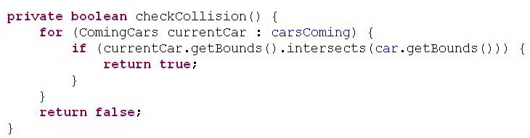
Collision
The implementation of car collision

Slide 7
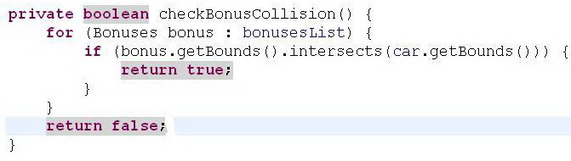
Collision
Implementation of bonus collision

Slide 8
Stats and conditions
In order to win our game, you must overcharge your car to 100%.
In order to do that you must collect the bonuses.
However, if you get hit by enough cars, and the integrity of the car reaches 0, you lose the game.

Slide 9
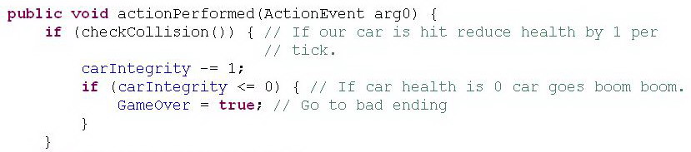
Conditions

Slide 10

Stats
In order to know how well you are doing in the game, we have added stats which keep track of your car integrity and overcharge.

Slide 11
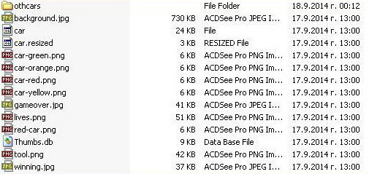
Sprites
We used numerous sprites for the different cars, the roads, and the bonuses.
Thanks to that our game looks good.

Slide 12
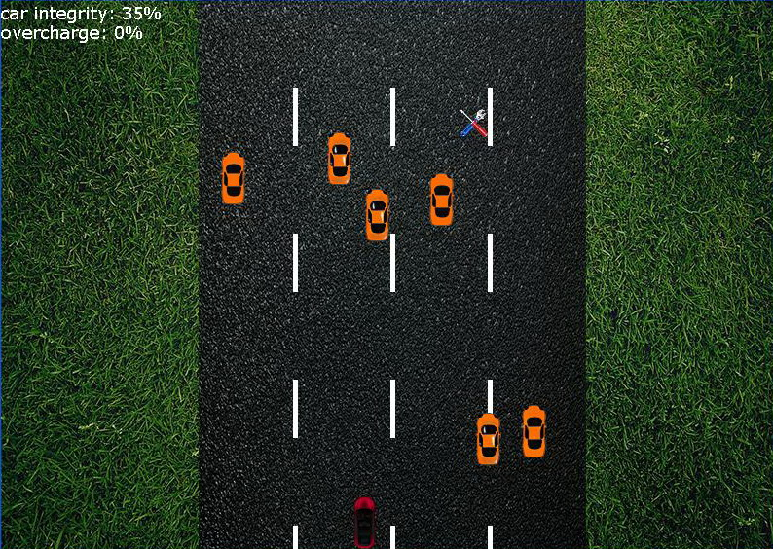

Slide 13
In conclusion
Niki made the car move.
Hristo made traffic spawn and move.
Rosi made the game much more visually appealing.
Alex implemented collision.
Emo implemented stats and finished the code.
Ivan made the presentation ( will also buy beers for the rest of the team )

Slide 14


